Slide 1


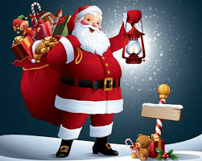

Christmas 2023
Christmas Color Party with Olympic games at the beach
11:00-12:30
Christmas Cocktail Reception with Soft Music Performance at Sayadeya terrace
18:30-19:00
Christmas Gala Dinner Buffet in Sayadeya with Violin
19:15-20:30
Kid’s Christmas Party & 2 masks Show at Disco
20:30-21:30
Christmas Party with live Cuban Band at Lobby Bar
20:30-21:00
Christmas Animation Show at Lobby Bar
21:00-21:15
Christmas Party with Belly Dancer at Lobby Bar
21:15-21:45
Christmas Animation Show at Lobby Bar
21:45-22:00
Christmas Colombian Show at Lobby Bar
22:00-22:30
Christmas Party with Live Cuban Band with dance Floor at Lobby Bar
22:45-23:30
25/12/2023
Arrival of Santa Claus with camel distributing presents to all kids at the beach area with chocolate
11:00-12:30
Live Cuban Band
15:00-16:30

